Slide 1
Parallel Programming C#

Slide 2
Task parallel library (TPL)
TPL minimizes the complexity of using threads and provides an abstraction through a set of APIs that helps developers to focus more on the application program instead of focusing on how the threads will be provisioned
Benefits
It autoscales the concurrency to a multicore level
It autoscales LINQ queries to a multicore level
It handles the partitioning of the work and uses ThreadPool where required
It is easy to use and reduces the complexity of working with threads directly

Slide 3
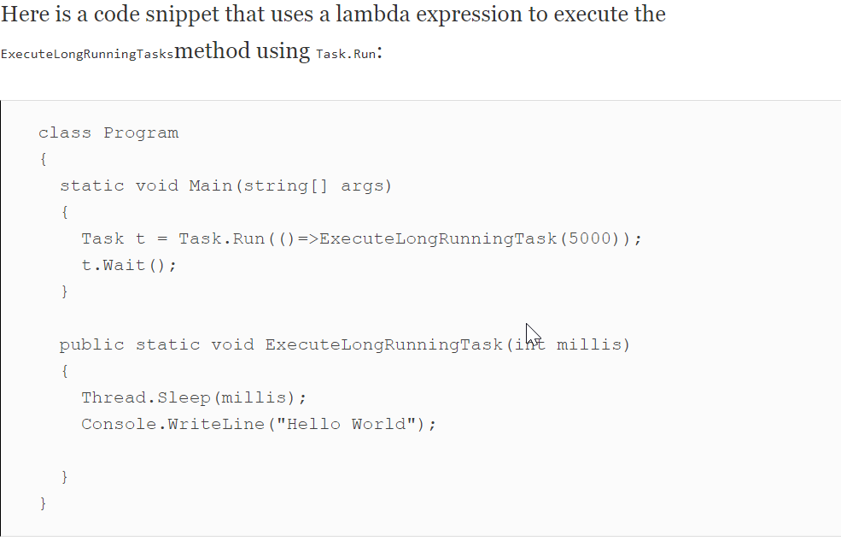
Creating a task using TPL
An asynchronous task can be run by calling either the Task.Run or TaskFactory.StartNew methods.
While calling the Task.Factory.StartNew method, we can specify CancellationToken, TaskCreationOptions, and TaskScheduler to set the state, specify other options, and schedule tasks.
TPL uses multiple cores of the CPU out of the box. When the task is executed using the TPL API, it automatically splits the task into one or more threads and utilizes multiple processors, if they are available.

Slide 4
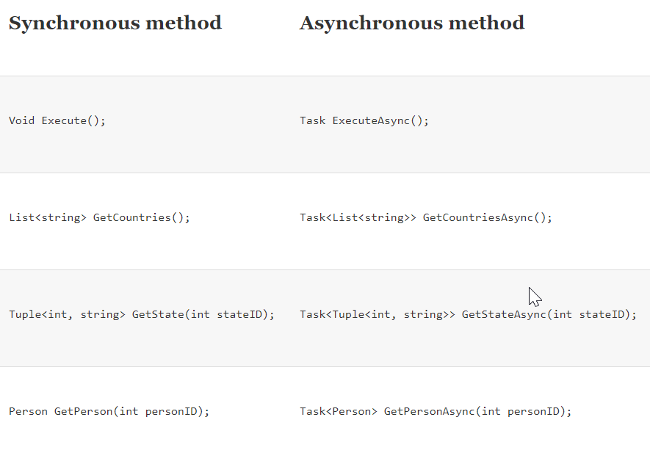
Task-based asynchronous pattern (TAP)
Naming convention
The method executing asynchronously should have the naming suffix Async. For example, if the method name starts with ExecuteLongRunningOperation, it should have the suffix Async, with the resulting name of ExecuteLongRunningOperationAsync
Return type
The method signature should return either a System.Threading.Tasks.Task or System.Threading.Tasks.Task<TResult>. The task’s
return type is equivalent to the method that returns
void, whereas TResult is the data type.
Parameters
The out and ref parameters are not allowed as parameters in the method signature. If multiple values need to be returned, tuples or a custom data structure can be used. The method should always return Task or Task<TResult>, as discussed previously

Slide 5
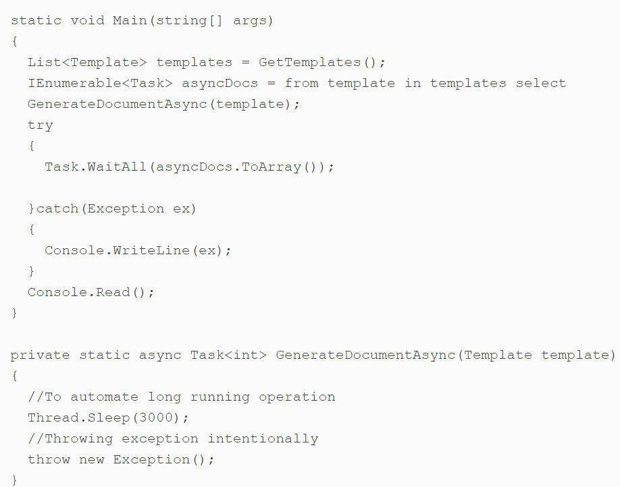
Exceptions
The asynchronous method should always throw exceptions that are assigned to the returning task. However, the usage errors, such as passing null parameters to the asynchronous method, should be properly handled.
When calling an asynchronous method, the exception is actually hidden until the Wait, WaitAll, WhenAll, and other methods are called. In the preceding example, the exception will be thrown once the Task.WaitAll method is called, and will log the exception on the console.

Slide 6
Task status
The task object provides a TaskStatus that is used to know whether the task is executing the method running, has completed the method, has encountered a fault, or whether some other occurrence has taken place. The task initialized using Task.Run initially has the status of Created, but when the Start method is called, its status is changed to Running. When applying the TAP pattern, all the methods return the Task object, and whether they are using the Task.Run inside, the method body should be activated. That means that the status should be anything other than Created. The TAP pattern ensures the consumer that the task is activated and the starting task is not required.
Task cancellation
Cancellation is an optional thing for TAP-based asynchronous methods. If the method accepts the CancellationToken as the parameter, it can be used by the caller party to cancel a task. However, for a TAP, the cancellation should be properly handled

Slide 7
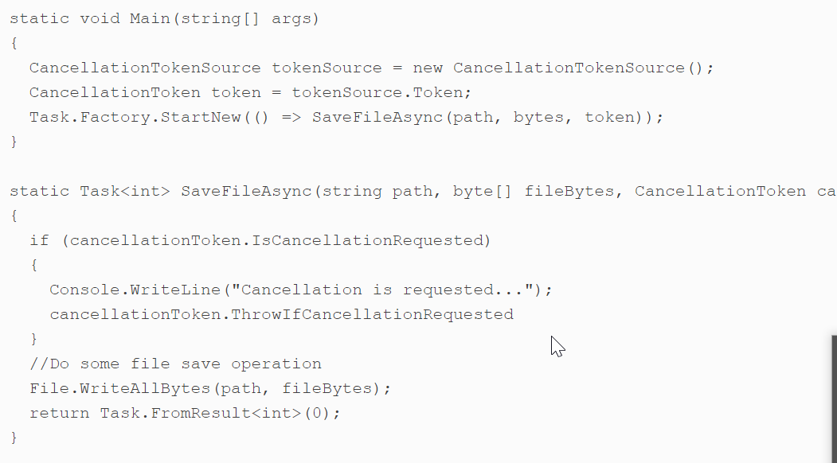
In the preceding code, we have a SaveFileAsync method that takes the byte array and the CancellationToken as parameters. In the Main method, we initialize the CancellationTokenSource that can be used to cancel the asynchronous operation later in the program. To test the cancellation scenario, we will just call the Cancel method of the tokenSource after the Task.Factory.StartNew method and the operation will be canceled. Moreover, when the task is canceled, its status is set to Cancelled and the IsCompleted property is set to true.

Slide 8
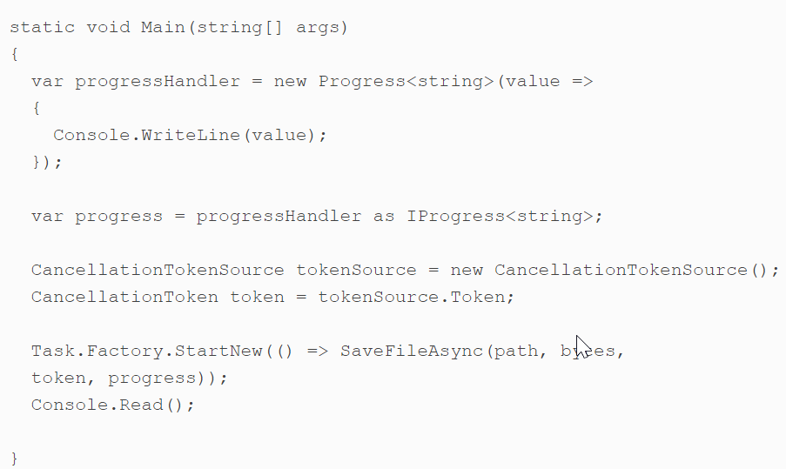
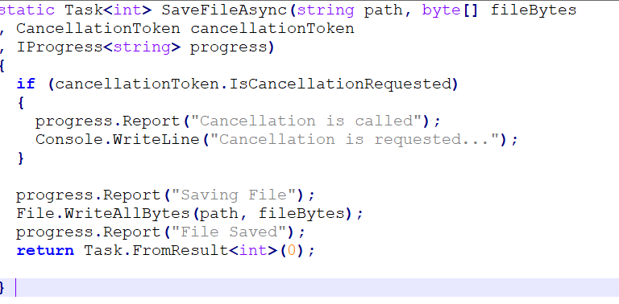
Task progress reporting
With TPL, we can use the IProgress<T> interface to get real-time progress notifications from the asynchronous operations. This can be used in scenarios where we need to update the user interface or the console app of asynchronous operations. When defining the TAP-based asynchronous methods, defining IProgress<T> in a parameter is optional. We can have overloaded methods that can help consumers to use in the case of specific needs. However, they should only be used if the asynchronous method supports them.

Slide 9
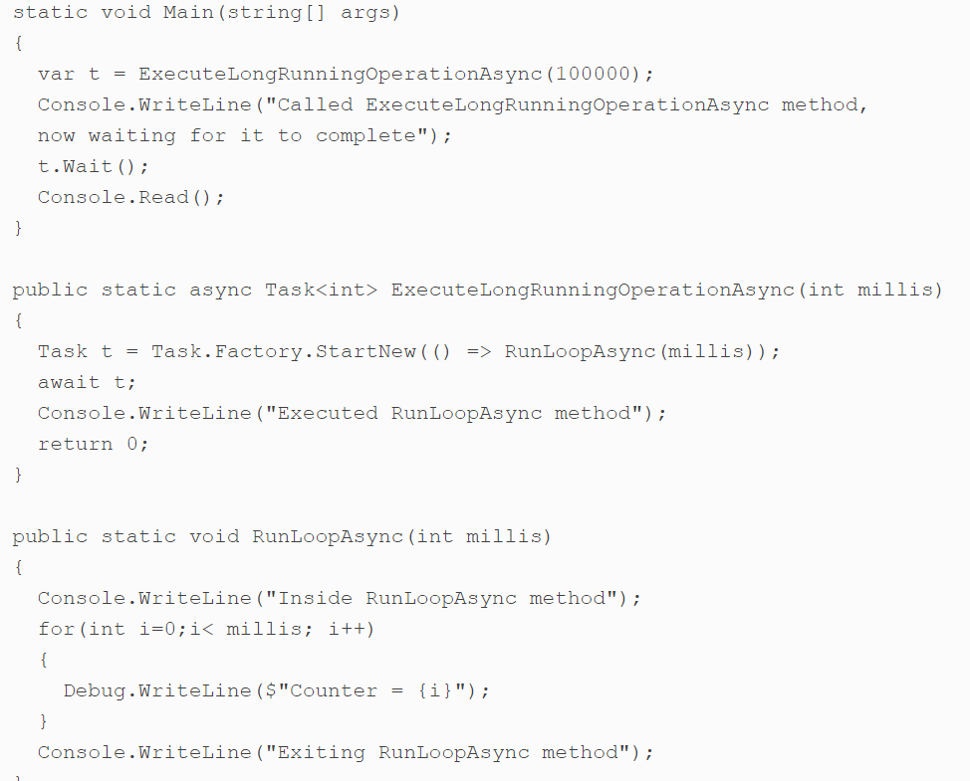
Implementing TAP using compilers
Any method that is attributed with the async keyword (for C#) or Async for (Visual Basic) is called an asynchronous method. The async keyword can be applied to a method, anonymous method, or a Lambda expression, and the language compiler can execute that task asynchronously.
In the preceding code, we have the ExecuteLongRunningOperationAsync method, which is implemented as per the compiler approach. It calls the RunLoopAsync that executes a loop for a certain number of milliseconds that is passed in the parameter. The async keyword on the ExecuteLongRunningOperationAsync method actually tells the compiler that this method has to be executed asynchronously, and, once the await statement is reached, the method returns to the Main method that writes the line on a console and waits for the task to be completed. Once the RunLoopAsync is executed, the control comes back to await and starts executing the next statements in the ExecuteLongRunningOperationAsync method.

Slide 10
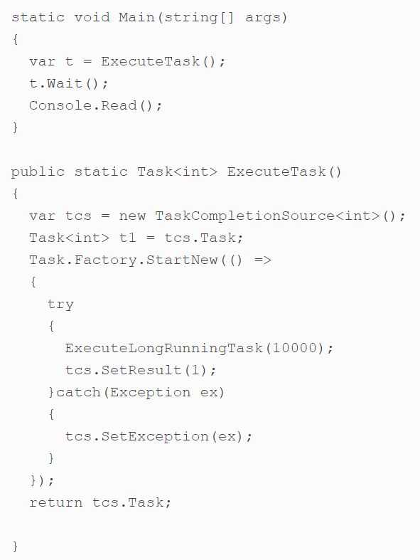
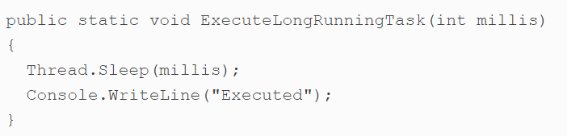
Implementing TAP with greater control over Task
The TaskCompletionSource<TResult> object is used to create a task that executes an asynchronous operation. When the asynchronous operation completes, we can use the TaskCompletionSource<TResult> object to set the result, exception, or state of the task.

Slide 11
Design patterns for parallel programming
There are various ways in which the tasks can be designed to run in parallel. In this section, we will learn some top design patterns used in TPL:
Pipeline pattern
Dataflow pattern
Producer-consumer pattern
Parallel.ForEach
Parallel LINQ (PLINQ)

Slide 12
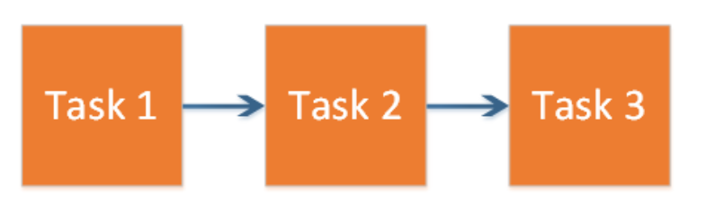
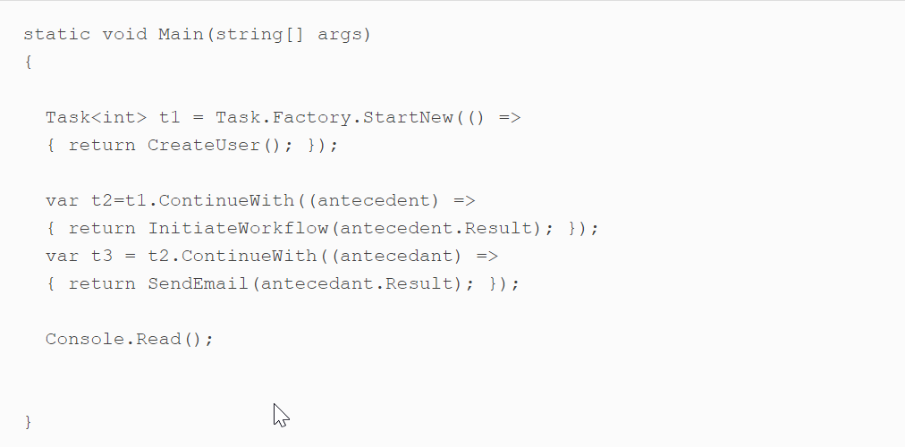
Pipeline pattern
The pipeline pattern is commonly used in scenarios where we need to execute the asynchronous tasks in sequence:
Consider a task where we need to create a user record first, then initiate a workflow and send an email. To implement this scenario, we can use the ContinueWith method of TPL. Here is a complete example:

Slide 13
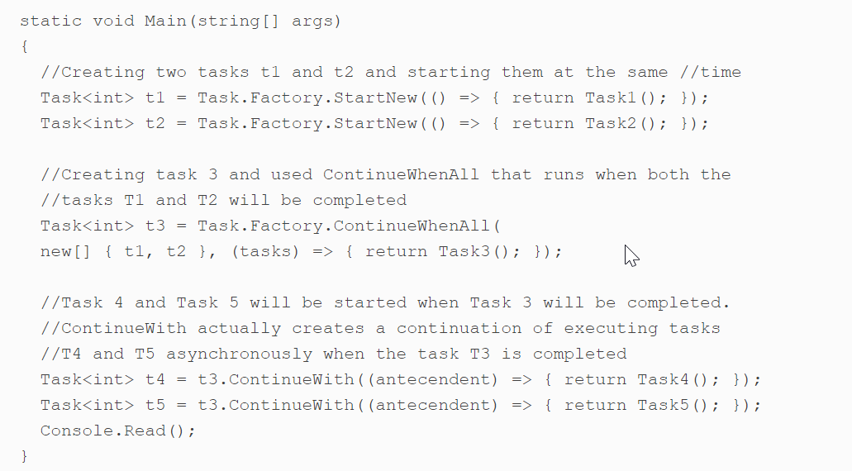
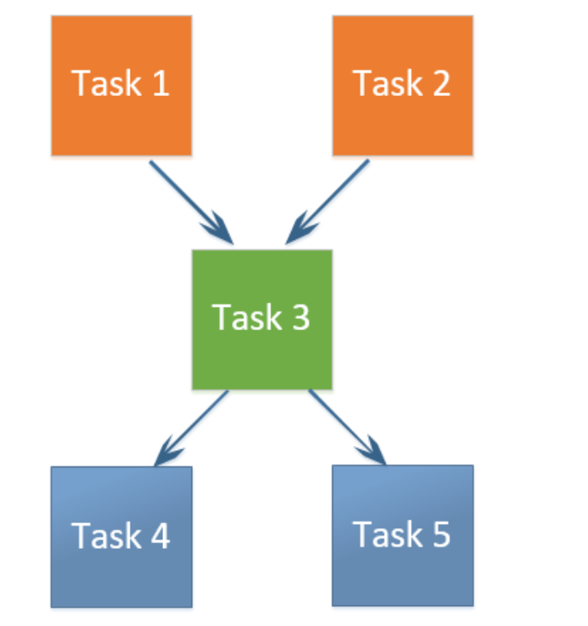
Dataflow pattern
The dataflow pattern is a generalized pattern with a one-to-many and a many-to-one relationship. For example, the following diagram represents two tasks, Task 1 and Task 2, that execute in parallel, and a third task, Task 3, that will only start when both of the first two tasks are completed. Once Task 3 is completed, Task 4 and Task 5 will be executed in parallel:

Slide 14
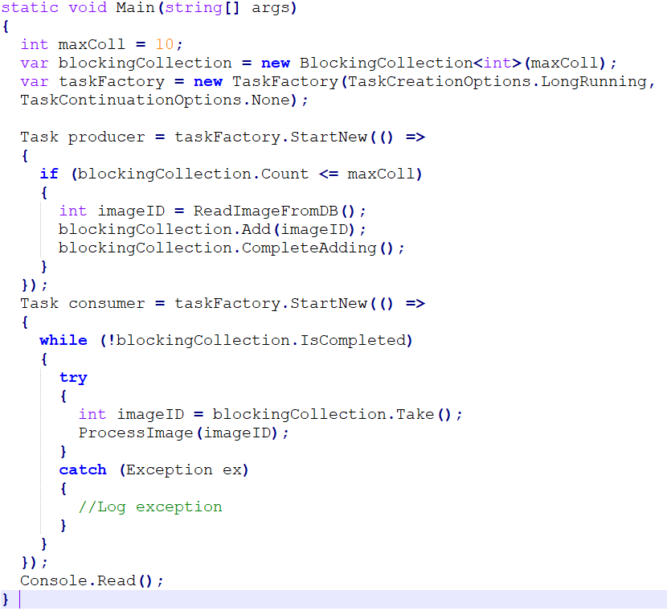
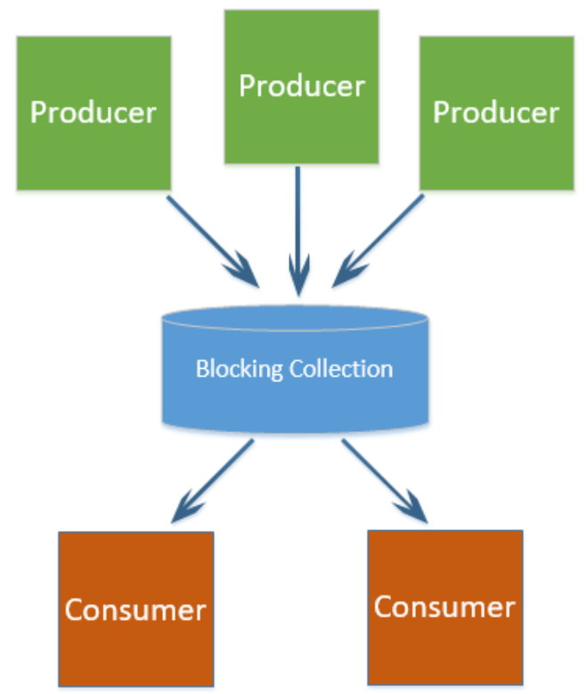
Producer/consumer pattern
One of the best patterns to execute long-running operations is the producer/consumer pattern. In this pattern, there are producers and consumers, and one or more producers are connected to one or more consumers through a shared data structure known as BlockingCollection. BlockingCollection is a fixed-sized collection used in parallel programming. If the collection is full, the producers are blocked, and if the collection is empty, no more consumers should be added:

Slide 15
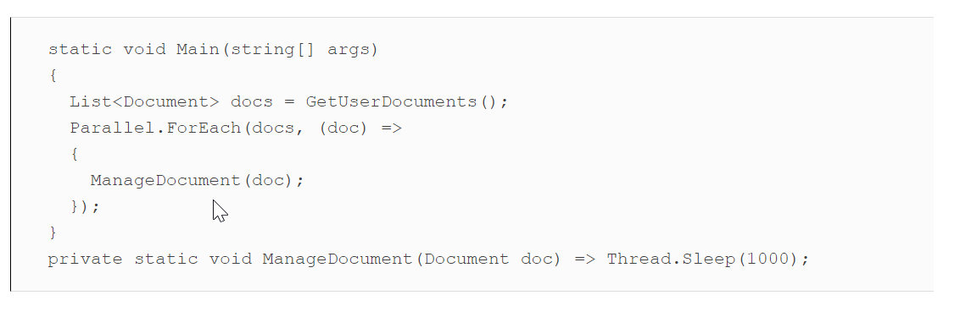
Parallel.ForEach
The Parallel.ForEach is a multithreaded version of the classic foreach loop. The foreach loop runs on a single thread, whereas the Parallel.ForEach runs on multiple threads and utilizes multiple cores of the CPU, if available.Here is a basic example using Parallel.ForEach on a list of documents that needs to be processed, and which contains an I/O-bound operation:

Slide 16
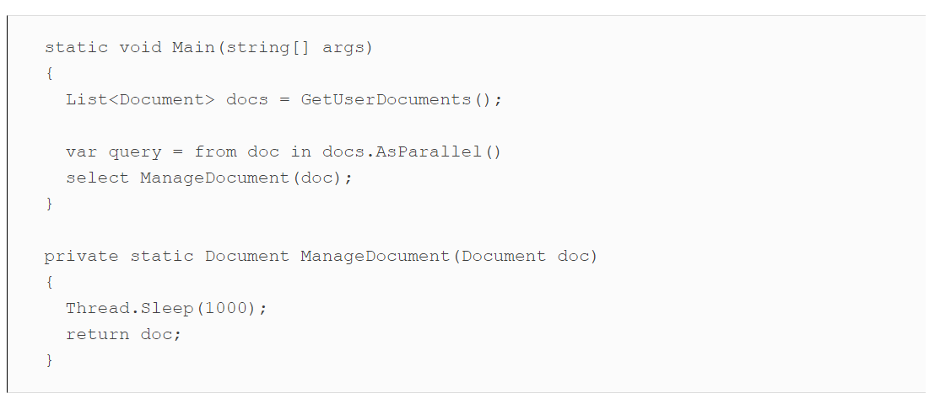
Parallel LINQ (PLINQ)
Parallel LINQ is a version of LINQ that executes queries in parallel on multi-core CPUs. It contains the full set of standard LINQ query operators plus some additional operators for parallel operations. It is highly advisable that you use this for long-running tasks, although incorrect use may slow down the performance of your app. Parallel LINQ operates on collections such as List, List<T>, IEnumerable, IEnumerable<T> and so on. Under the hood, it splits the list into segments and runs each segment on a different processor of the CPU.

